Slide 1

Philtre The Bistro
By
~Tushar Sharma

Slide 2
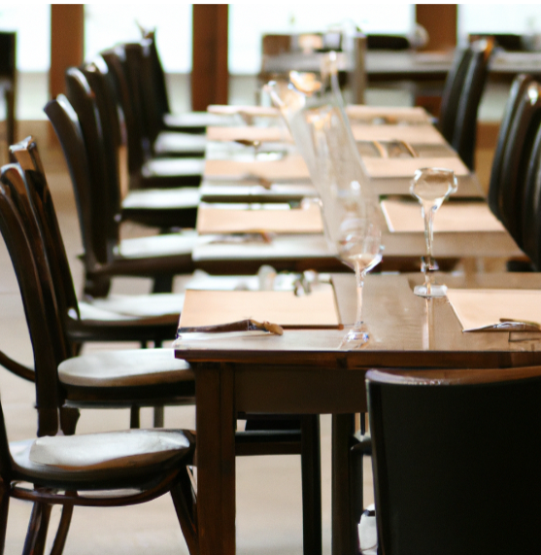
INTRODUCTION
Philtre The Bistro
In this application the user can see the complete menu and the admin of Philtre the Bistro can manage the services according to the needs.
And the management of services include the following scenarios:-
Insert any new Dish.
Update any dish with the help of DishId.
Delete any dish.

Slide 3







Step1: Choose the Frontend Framework and Tech Stack
Angular
HTML
CSS
Bootstrap
JavaScript
Typescript

Slide 4
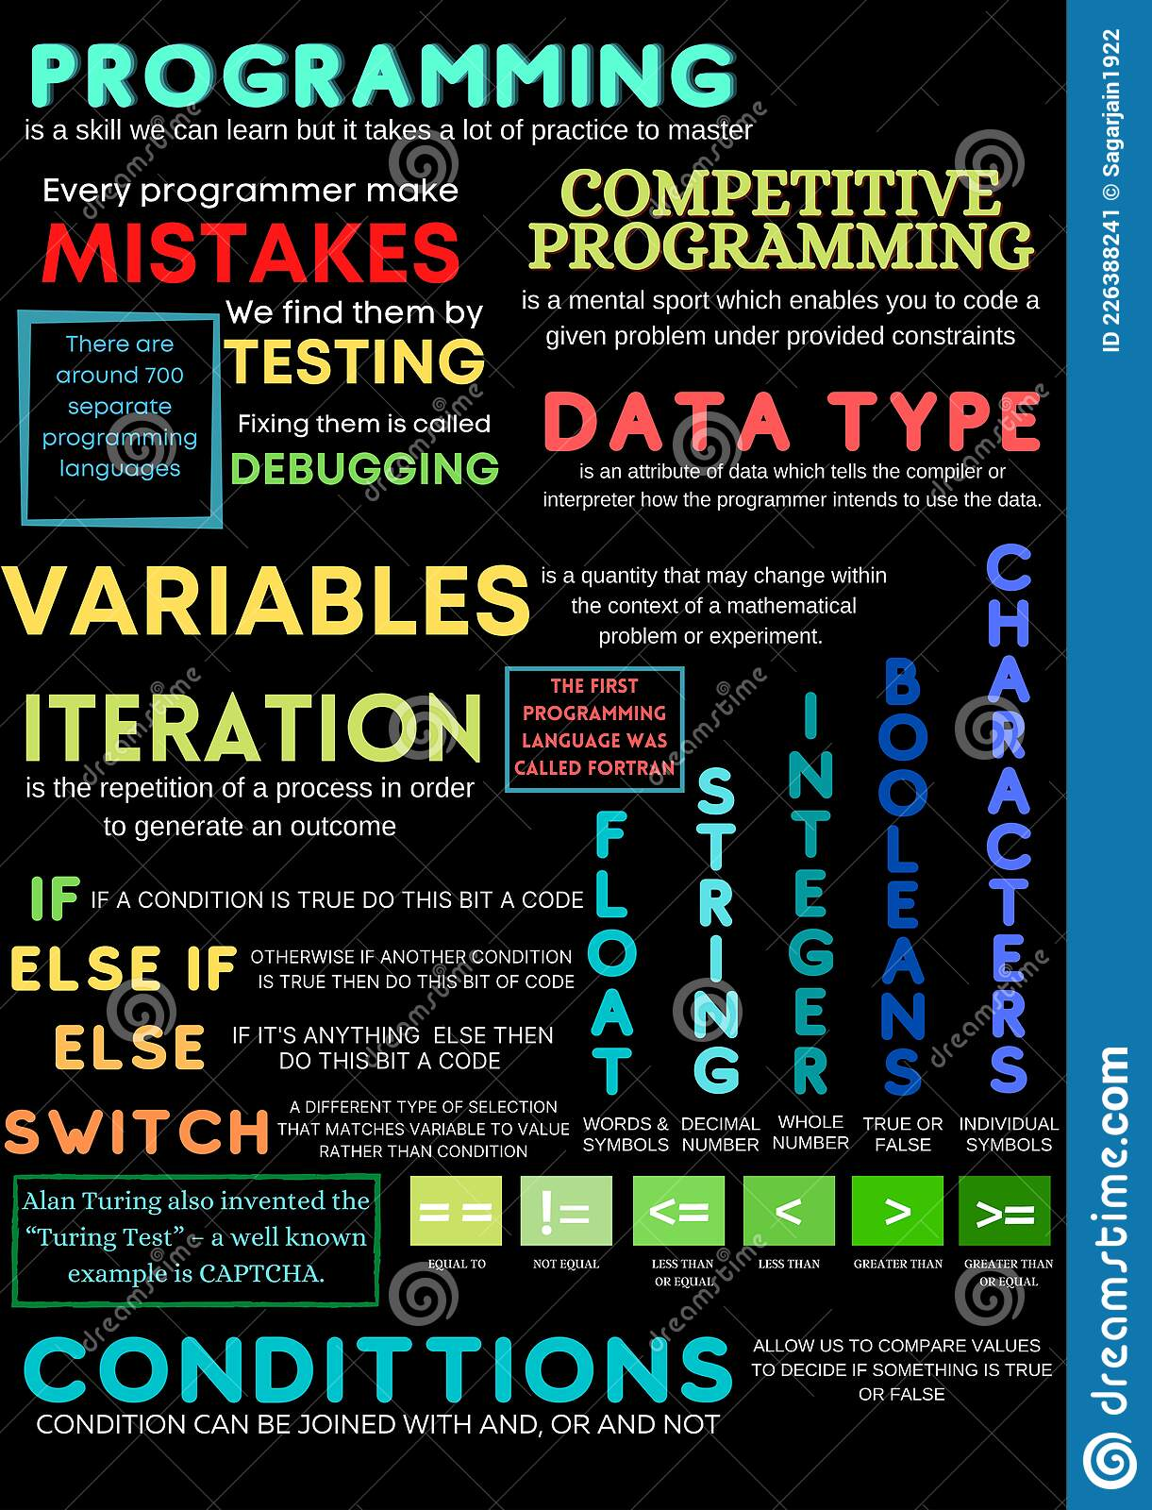



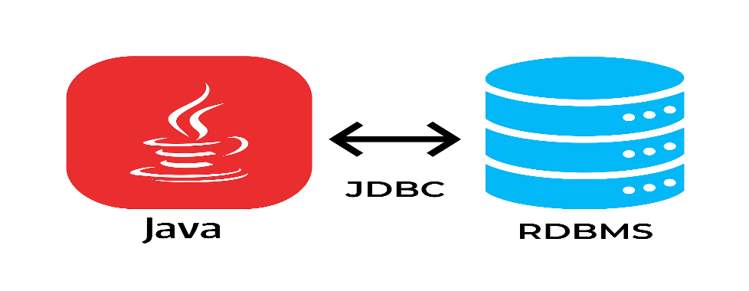
Step2: Choose the Backend Framework and Tech Stack
Spring boot
JAVA
Hibernate
JDBC

Slide 5
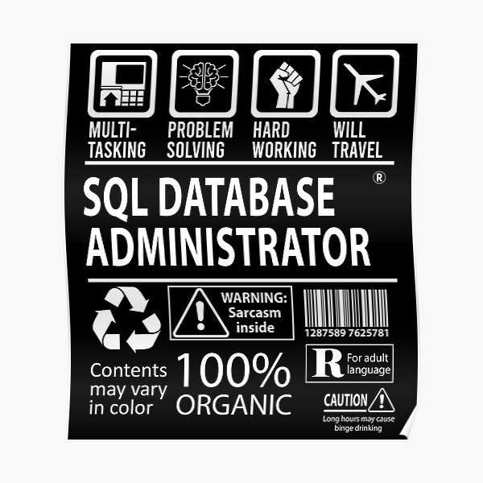

Step3: Choose the Database
Structured Query Language

Slide 6
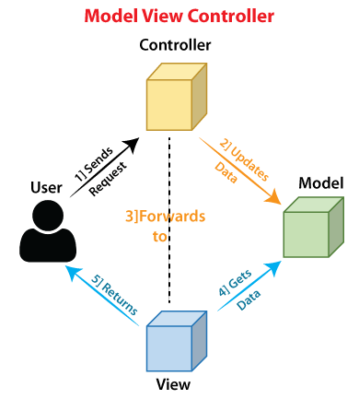
The complete Architecture of Full-Stack Application.

Slide 7
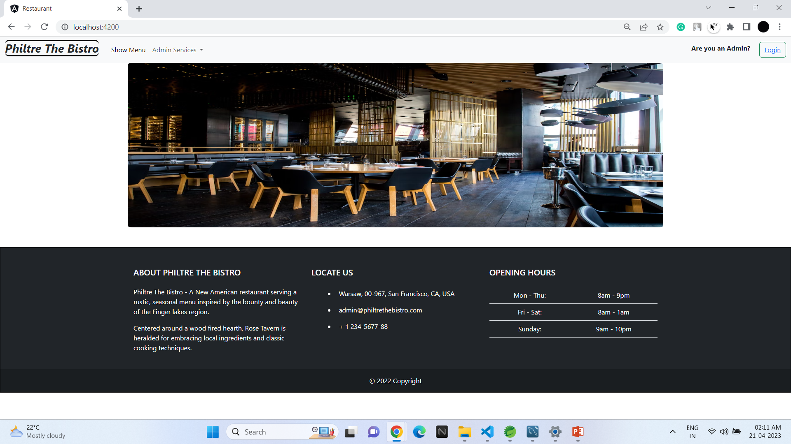
Philtre The Bistro – Home Page

Slide 8
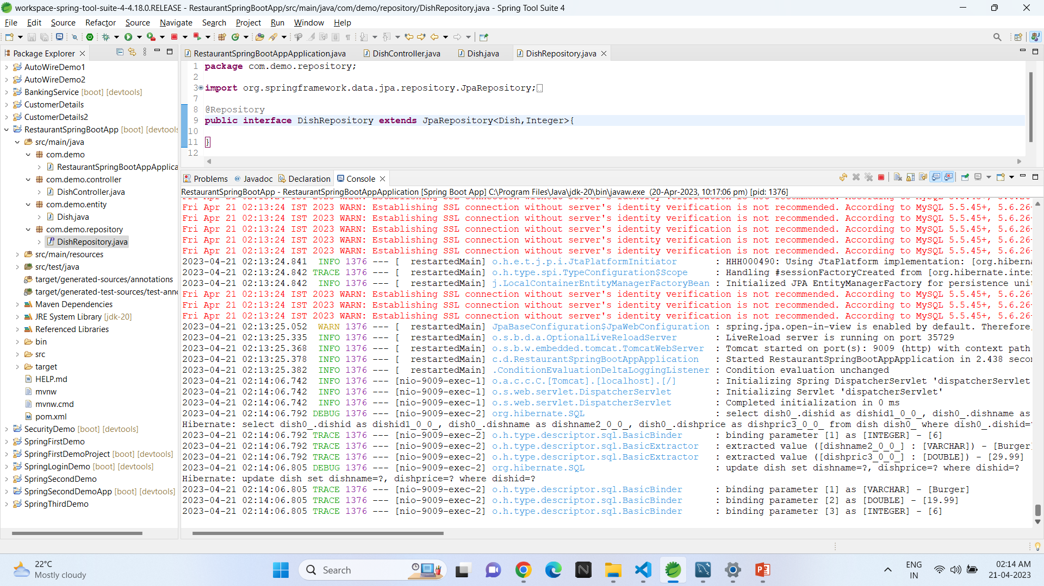
Philtre The Bistro – Spring App

Slide 9
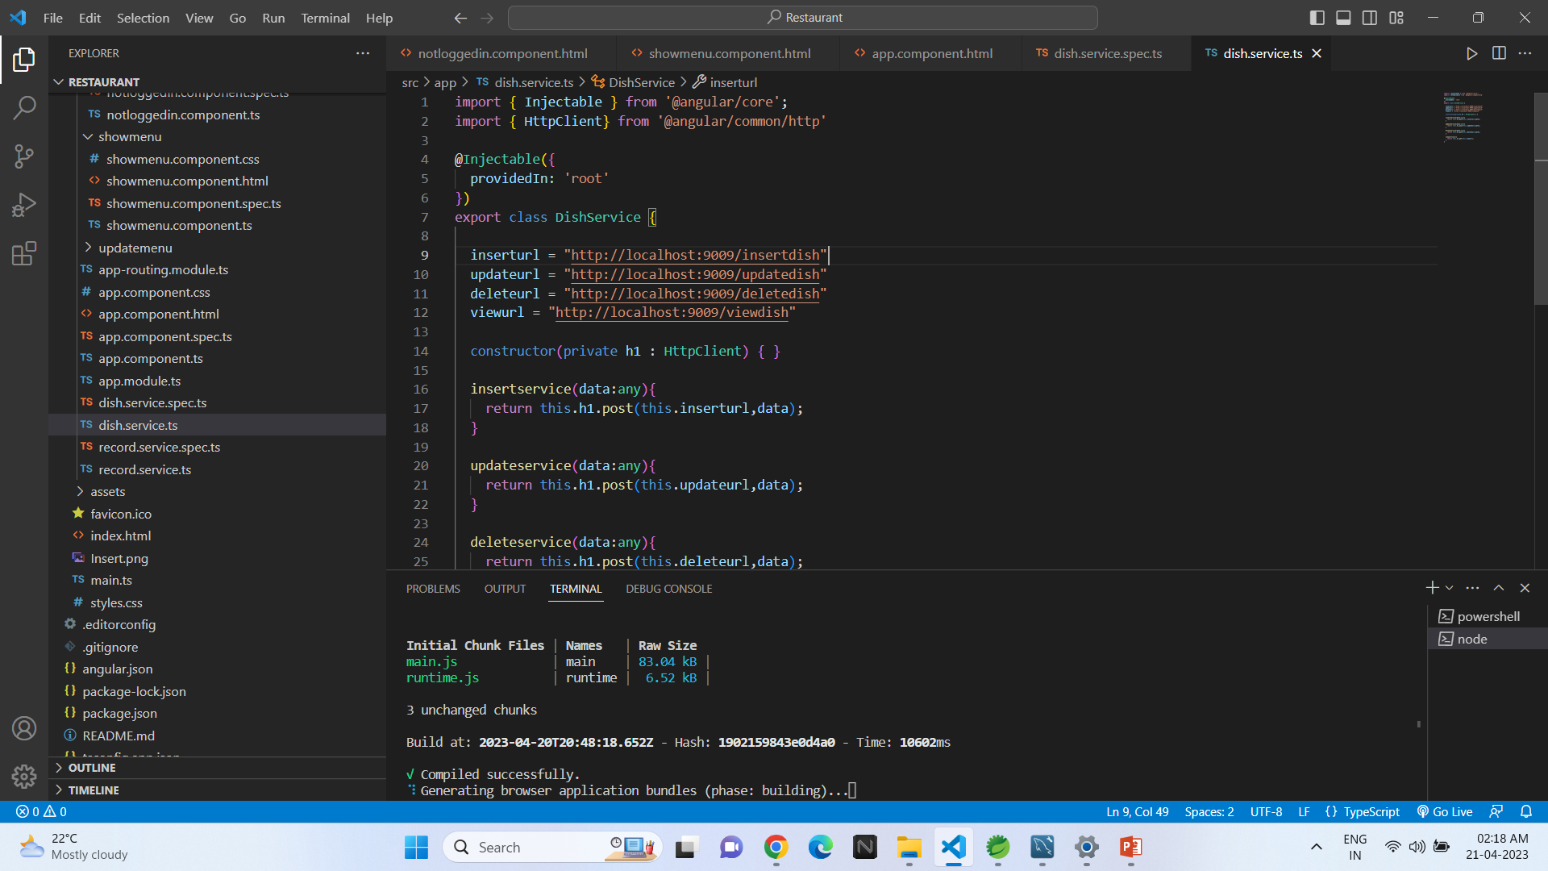
Philtre The Bistro – Angular JS

Slide 10
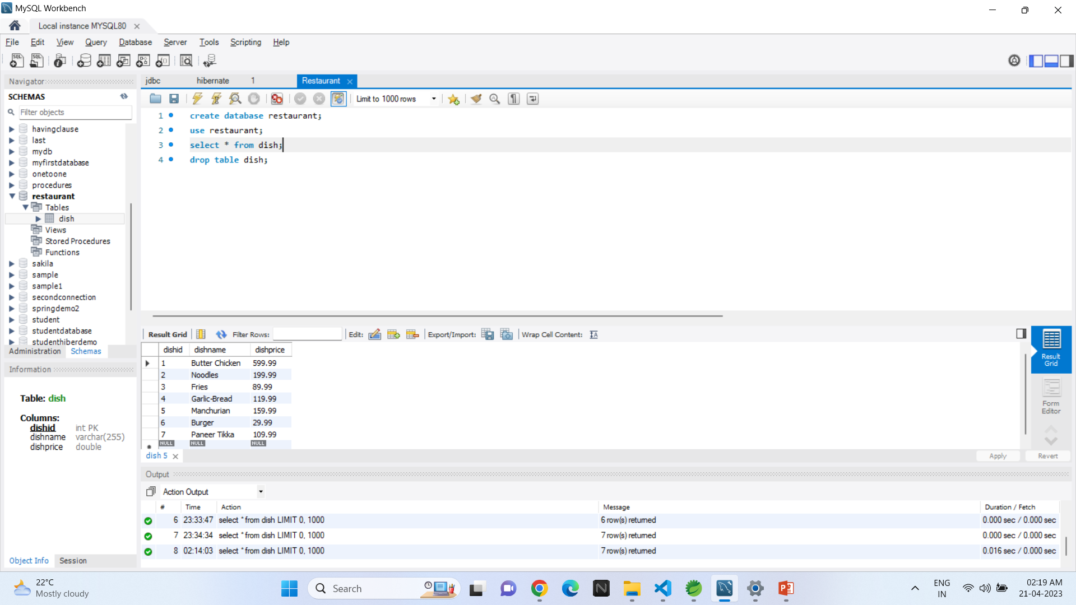
Philtre The Bistro – Database

Slide 11

Future Scope of the Project
Initially there is only ShowMenu and other admin services operations like insert dish, update the details of dish, and delete the specific dish implemented only.
Later other services like add food to cart so that the food can also be ordered from this webapp as well.
Post implementing all the required services we can launch this app as a part of a Start-Up.

Slide 12

GitHub Link

Slide 13

Thank You

